Slide 1

High power HOM couplers
James Mitchell (CERN)
On behalf of SY-RF-AC and HL-LHC WP4

Slide 2
Outline
Coupling mechanism
Fundamental mode rejection
High frequency transformation and HOM damping
Dynamic heat-load
Heating and multipacting
Feedthroughs
Characteristic impedance
HOM couplers for ERLs
LHC crab cavity HOM couplers
Design choices
Measurements
Test boxes
Without beam
With beam

Slide 3
HOM power in ERL’s
Prof. G. Burt (Lancaster University)
A key advantage of an ERL is it can operate at higher beam currents, but this is limited by BBU instabilities caused by HOMs
These HOMs need damping but due to the high currents this can be substantial powers beyond normal power handling for HOM couplers
For example the eRHIC ERL had 7 kW HOM power per cavity up to 40 GHz, and JLEIC ERL was 6 kW at highest currents ~ 240-300 mA
This level of power cannot be dissipated at cryogenic temperatures so the power needs to be extracted to a room temperature load
The integrated HOM power up to 5 GHz in eRHIC from Chen Xu

Slide 4
BLA’s and Coax
Prof. G. Burt (Lancaster University)
BLA
Current standard is using Beamline Absorbers (BLAs) placed in the warm section of the beampipe
Requires a large beampipe to ensure HOMs are not cut-off
This is not ideal for lower frequency HOMs - which tend to have the highest R/Q
Coaxial or waveguide couplers placed closer to the cavity, or even on-cell would allow more efficient damping of the most dangerous HOMs while allowing a decrease in the beampipe radius
Waveguides can handle the most power but can be rather large and can have large static heat leak if using warm loads
Recent studies at LHC have developed kW level coaxial HOM couplers which offer a compact solution
Images from B. Xiao

Slide 5
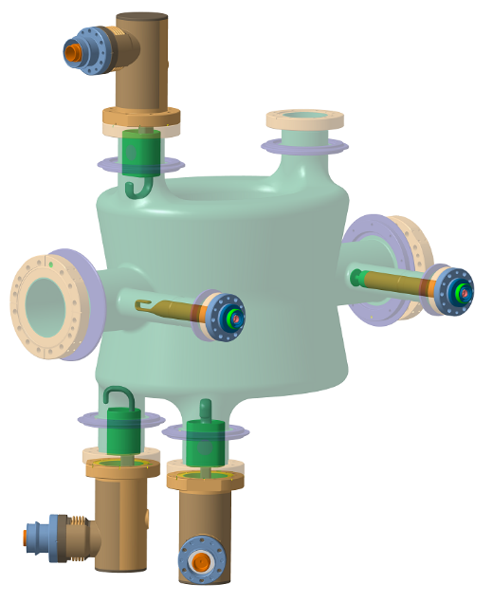
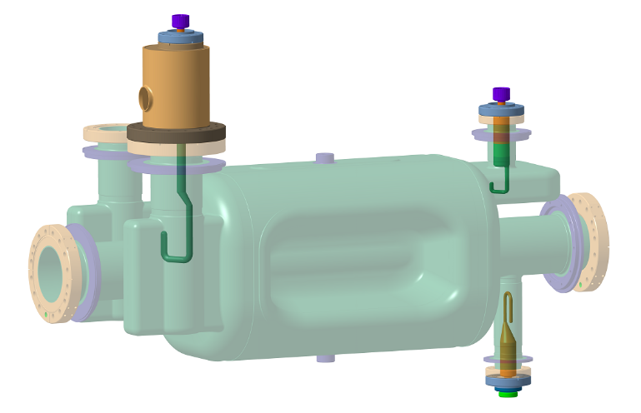
Crab cavity HOM couplers
Two crab cavities for High Luminosity Large Hadron Collider (HL-LHC)
Double Quarter Wave
(DQW)
Radio Frequency Dipole
(RFD)

Slide 6
Crab cavity HOM couplers
Two crab cavities for High Luminosity Large Hadron Collider (HL-LHC)
Vertical HOM coupler (V-HOMC)
High frequency HOM coupler
HOM couplers
Horizontal HOM coupler (H-HOMC)
Double Quarter Wave
(DQW)
Radio Frequency Dipole
(RFD)

Slide 7
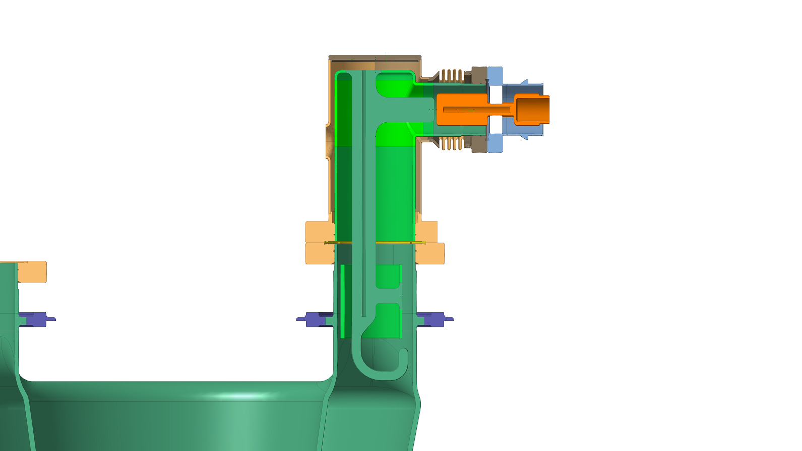
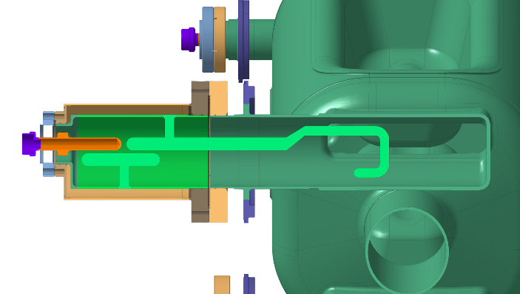
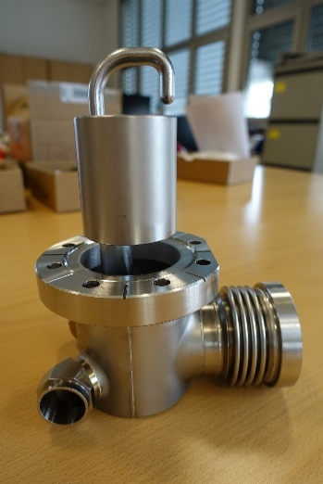
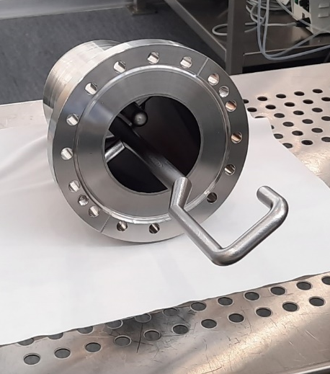
Crab cavity HOM couplers
Both cavities have one coupler with high power handling requirements (> 1 kW).
DQW HOM couplers
RFD Horizontal HOM coupler (H-HOMC)

Slide 8
Design choices

Slide 9


Coupling mechanisms
Mode topology of high impedance HOMs – large magnetic flux
Coupling mechanisms:
Electric (probe)
Magnetic (loop)
Magnetic [+ electric + removable] (hook)
On/off cell:
DQW
RFD
DQW: on-cell
Stronger field coupling for HOMs
Higher fundamental mode field
RFD: mounted on waveguide
Natural cut-off for fundamental mode
Waveguides add manufacturing complexity

Slide 10
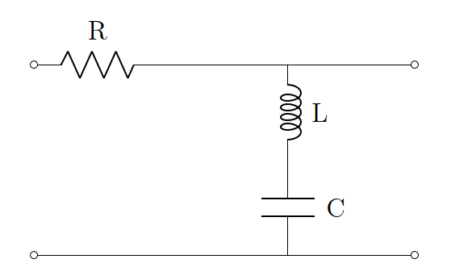


Fundamental mode rejection
Other types:
Quarter wave rejection
External Chebyshev filters
Refer to HOM coupler literature review [1]
DQW: LC band-stop filter
  Broad rejection response
  Difficult geometry to manufacture and weld
ω_{c} $=\frac{1}{\sqrt{LC}}$
Rectangular cross-section and flat section on ‘can’ makes manufacture much easier!
RFD: Waveguide cut-off and ladder filter notch
  ‘Simple components’
  Sensitive to tolerances
a
$$\frac{c}{2f_{HOM1}}<a<\frac{c}{2f_{0}}$$

Slide 11
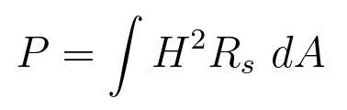
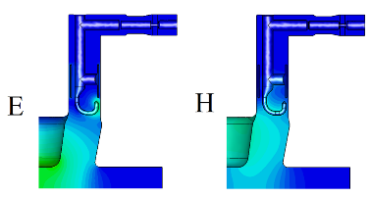


Dynamic heat loads
Fundamental mode rejection…
Material | R_{s} @ 2 K [Ohms]
Copper | ~ 1 e-3
Niobium | ~ 20 e-9
Can be high on copper gasket if fundamental mode is not sufficiently rejected.
Rejection filter before gasket.
Complicated geometry
High fields on hook
Broad notch (mW level heat-load)
Waveguide with f_{c} > 400 MHz
Hard to machine and weld
Higher nominal gasket heat-load
Less sensitive to tolerances
ω_{c} $=\frac{1}{\sqrt{LC}}$
a
$$\frac{c}{2f_{HOM1}}<a<\frac{c}{2f_{0}}$$
DQW
RFD

Slide 12


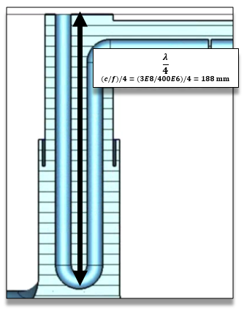
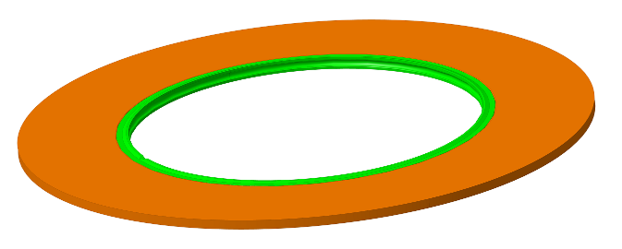
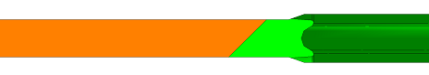
Dynamic heat loads
Fundamental mode rejection…
Material | R_{s} @ 2 K [Ohms]
Copper | ~ 1 e-3
Niobium | ~ 20 e-9
Could complex band-stop geometries be removed with superconducting seals?
Could a more complex gasket achieve simpler couplers for mass manufacture?
Could coupler welding start becoming more popular?

Slide 13

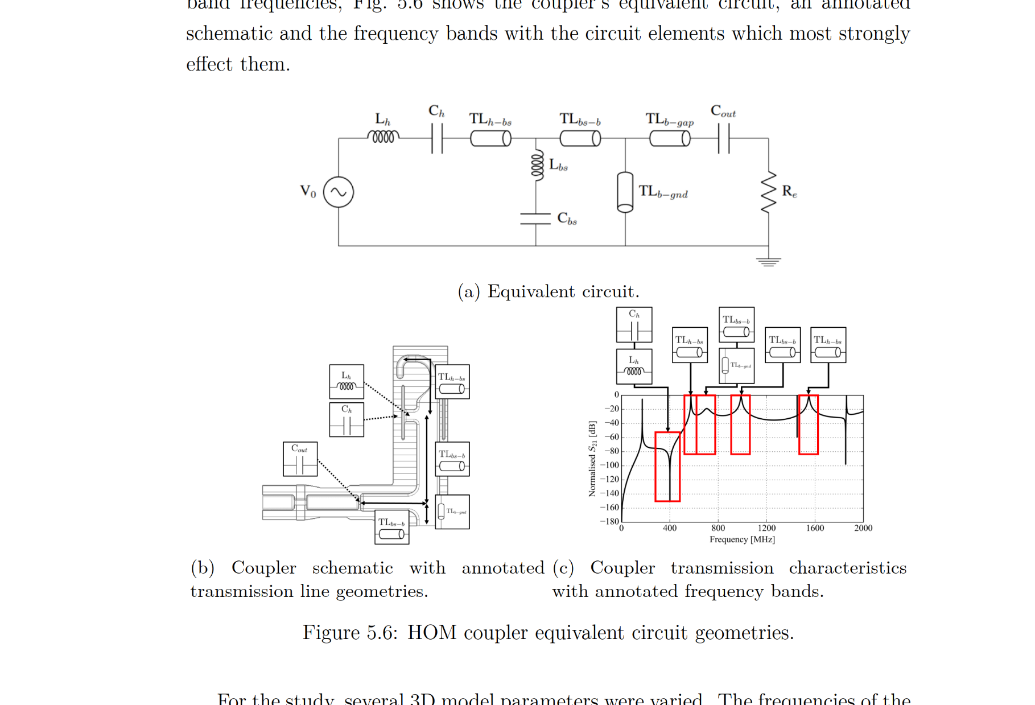
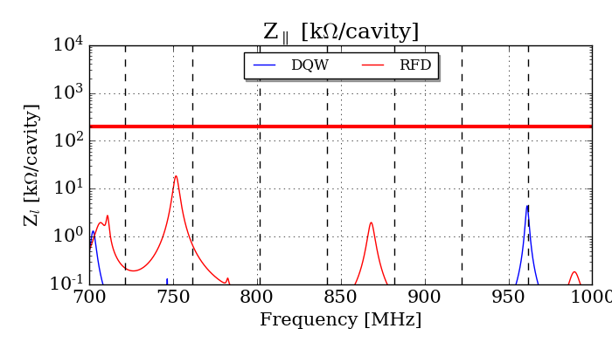
HOM damping
Tuned transformation networks to meet impedance limits defined for beam stability.
Additional limit of 1 kW for HOM heat load.
Both cavities have one ‘high power HOM’.
RFD
DQW

Slide 14

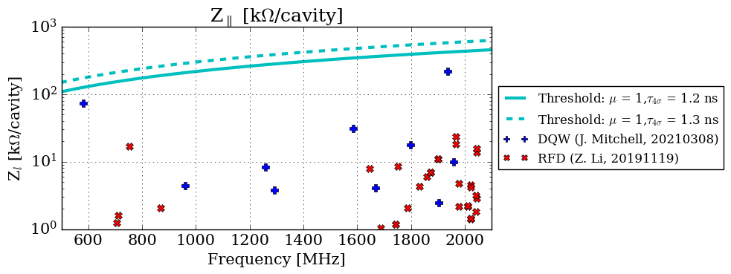
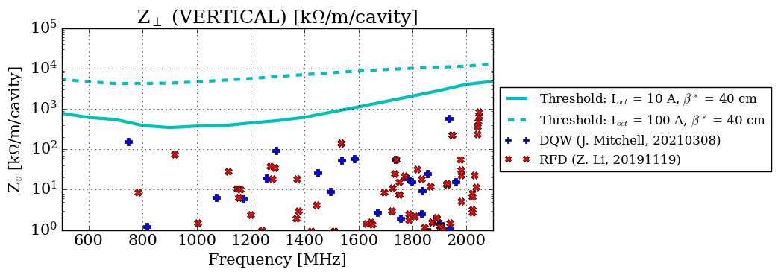
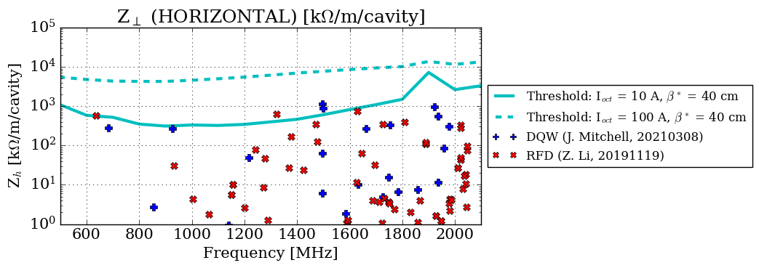

HOM damping
Tuned transformation networks to meet impedance limits defined for beam stability.
Additional limit of 1 kW for HOM heat load.
Both cavities have one ‘high power HOM’.
STRICT Frequency / Q-factor requirements!
RFD
DQW

Slide 15
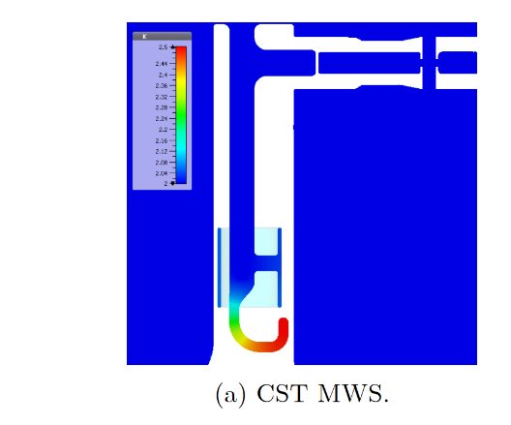
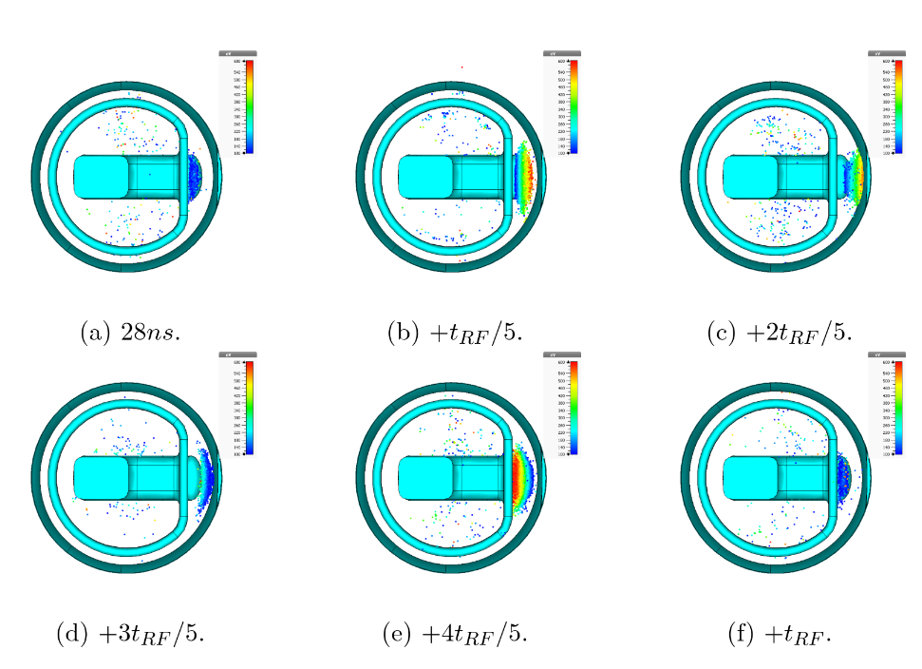
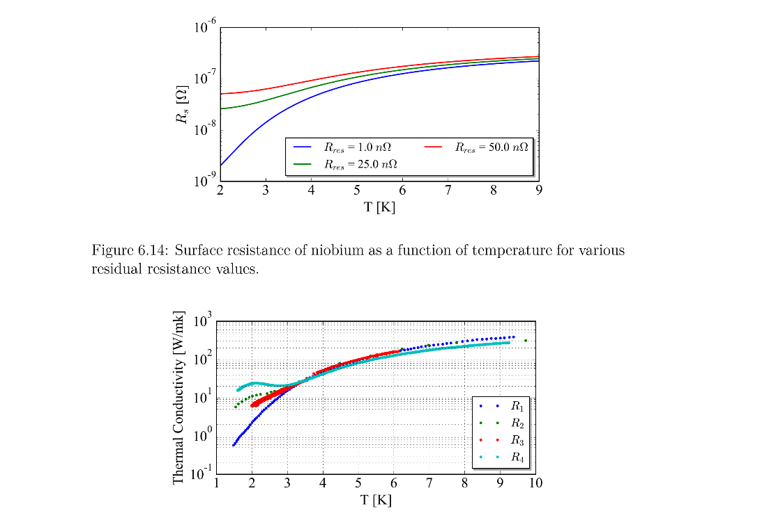

Heating and multipacting
Thermal and multipacting simulations were done for both couplers and cavities.
Important to incorporate the temperature dependent surface resistance and thermal conductivity!
Thermal
Multipacting

Slide 16
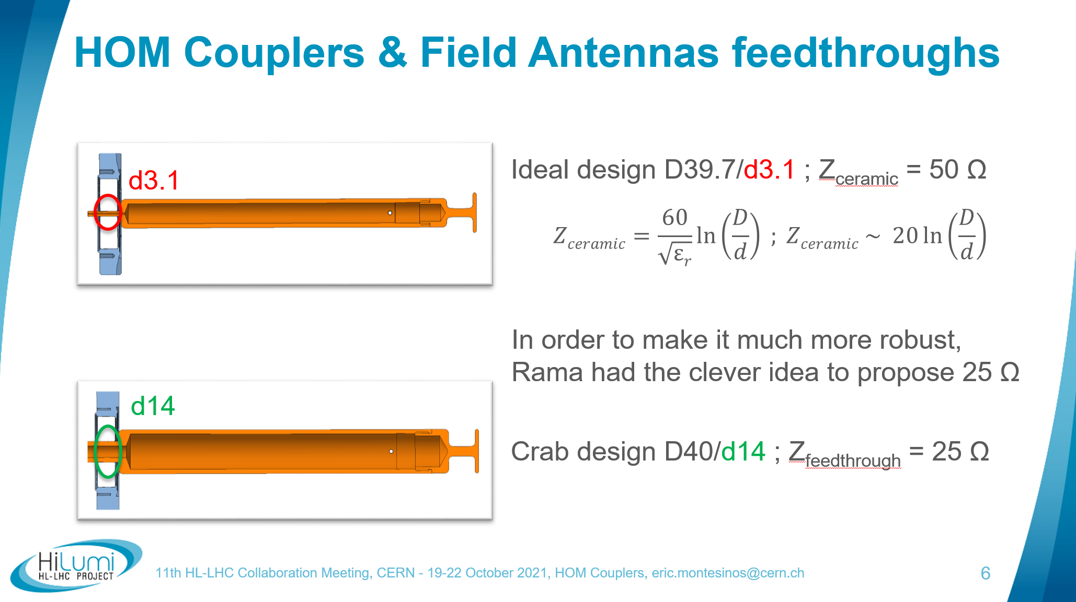
Characteristic Impedance (25 Ω)
Strength of inner conductor inside the window → transport concern
Decreasing Z₀, increases conductor thickness, increasing strength
E. Montesinos (CERN)

Slide 17

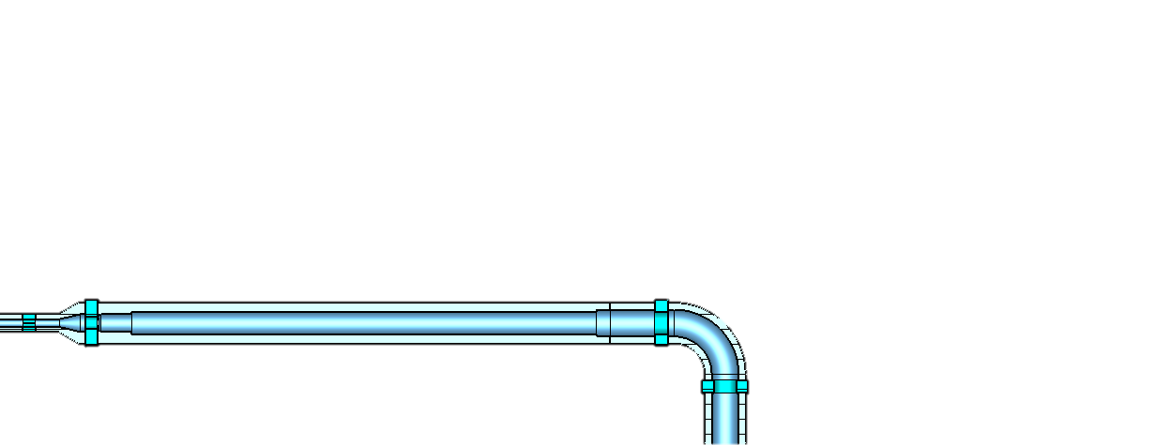
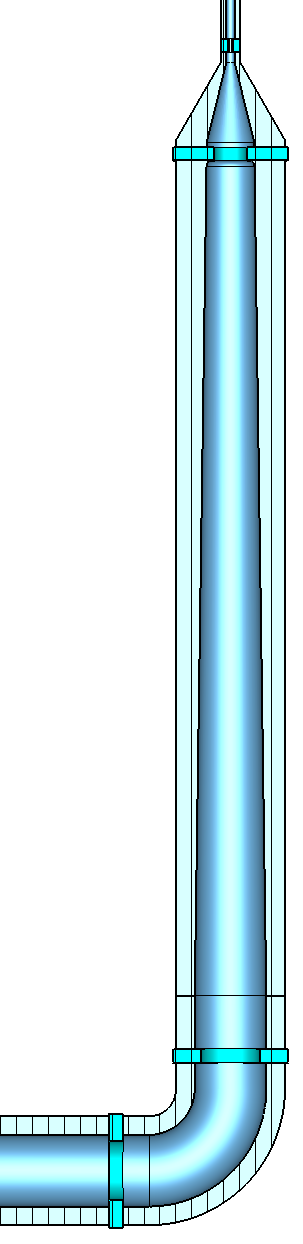
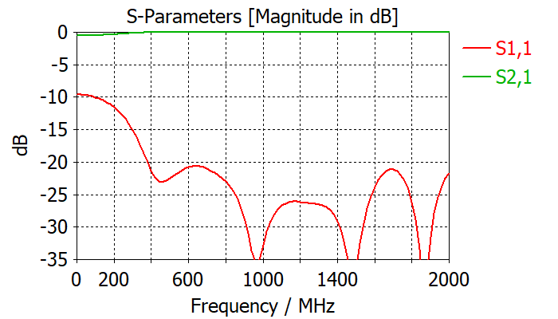
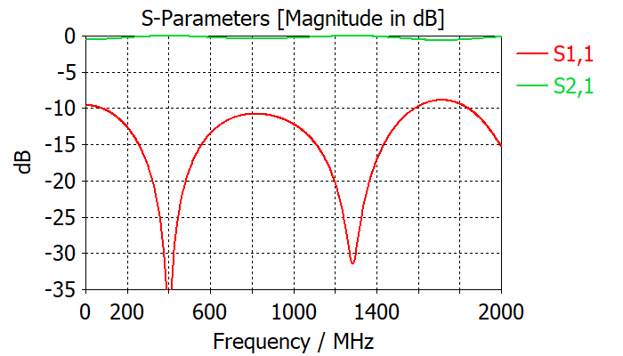
Impedance adapters
Developed with...
25 to 50 Ω adapters designed to qualify the HOM couplers and antennas before and after installation onto the cavity.
50 Ω
50 Ω
OD = 40 mm (25 Ω) → N-type (50 Ω)
Taper for broadband impedance transformation.
~ 450 mm
OD = 16 mm (25 Ω) → N-type (50 Ω)
Quarter wave transformer (400 MHz)
~ 300 mm
Could also use taper for broadband, but longer.
25 Ω
25 Ω
400 MHz

Slide 18

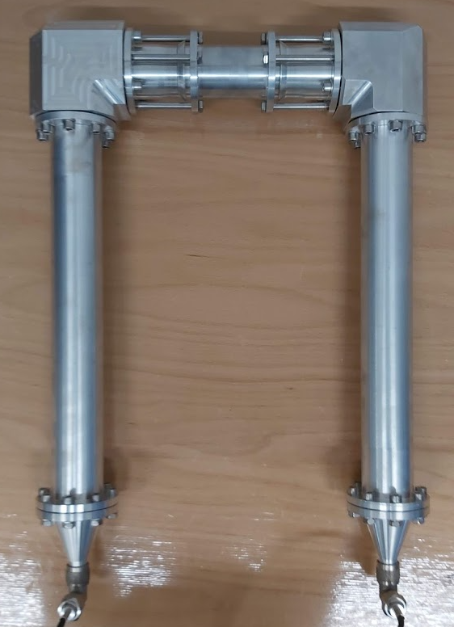
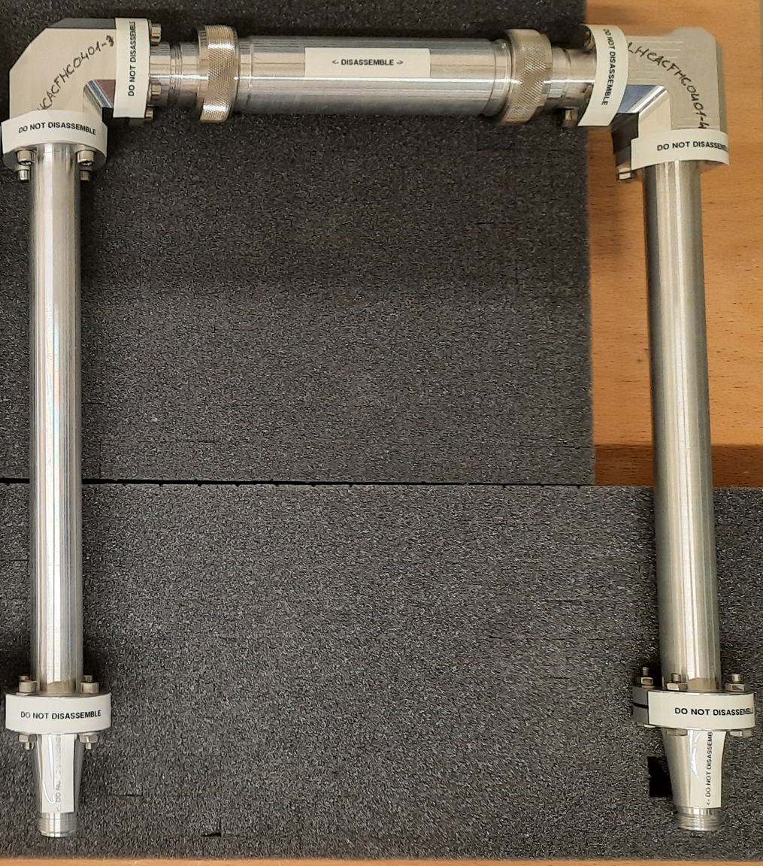
Impedance adapters
Developed with...
25 to 50 Ω adapters designed to qualify the HOM couplers and antennas before and after installation onto the cavity.
‘Back-to-back’ measurements qualified the adapters functionality
Back-to-back measurements
Adapter V/H-HOMC:
S21 > -0.5 dB broad-band
Adapter FA:
S21 > -0.1 dB at 400 MHz

Slide 19
Measurements

Slide 20
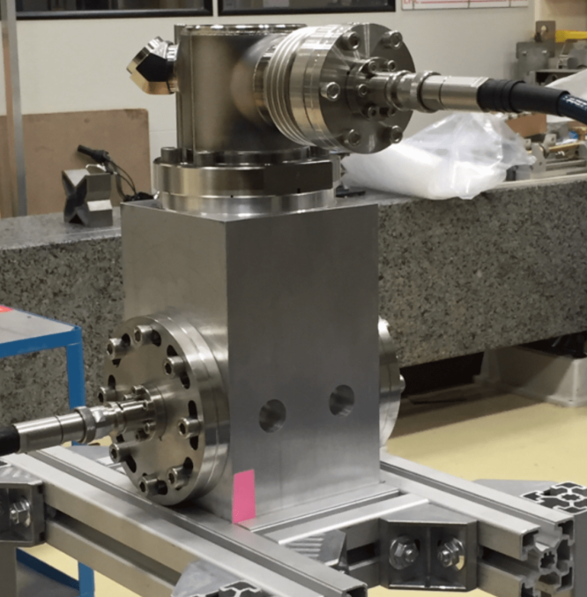
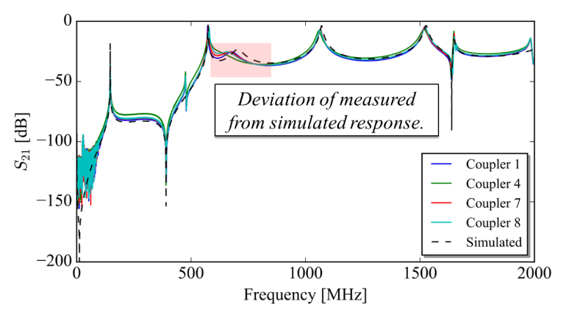

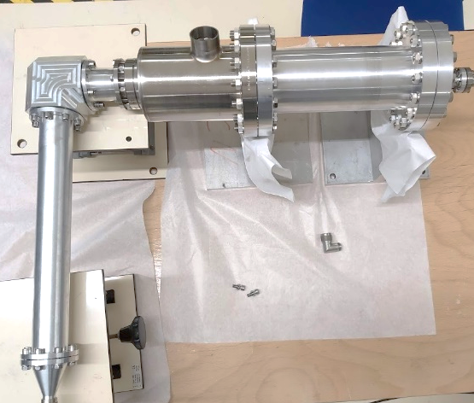
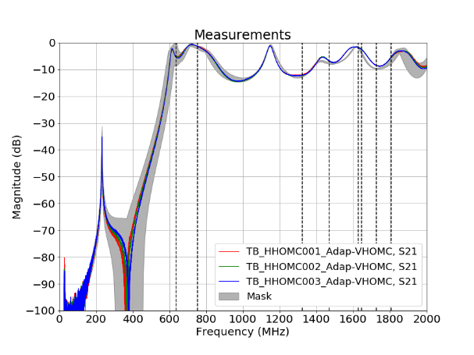

Test-box measurements
Developed with...
Text boxes designed to test and quantify the functionality of the couplers.
See if couplers work as designed BEFORE INSTALATION
Could use to tune notch frequency
Shown that HOM damping can be predicted with test box
Assign couplers to specific cavities / ports depending on response!

Slide 21
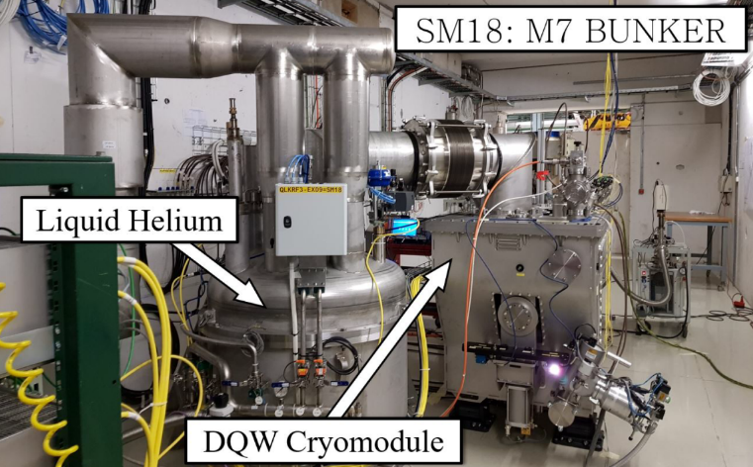
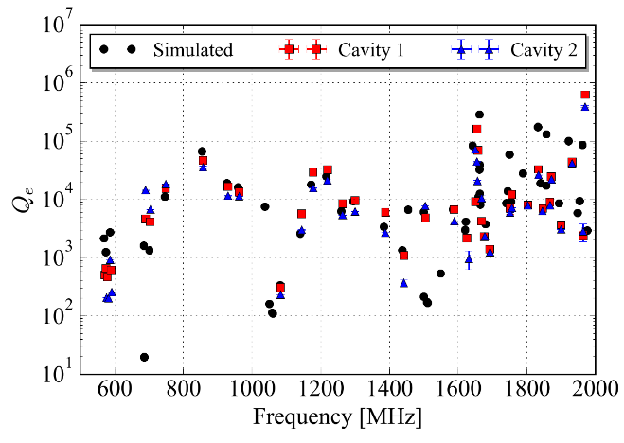
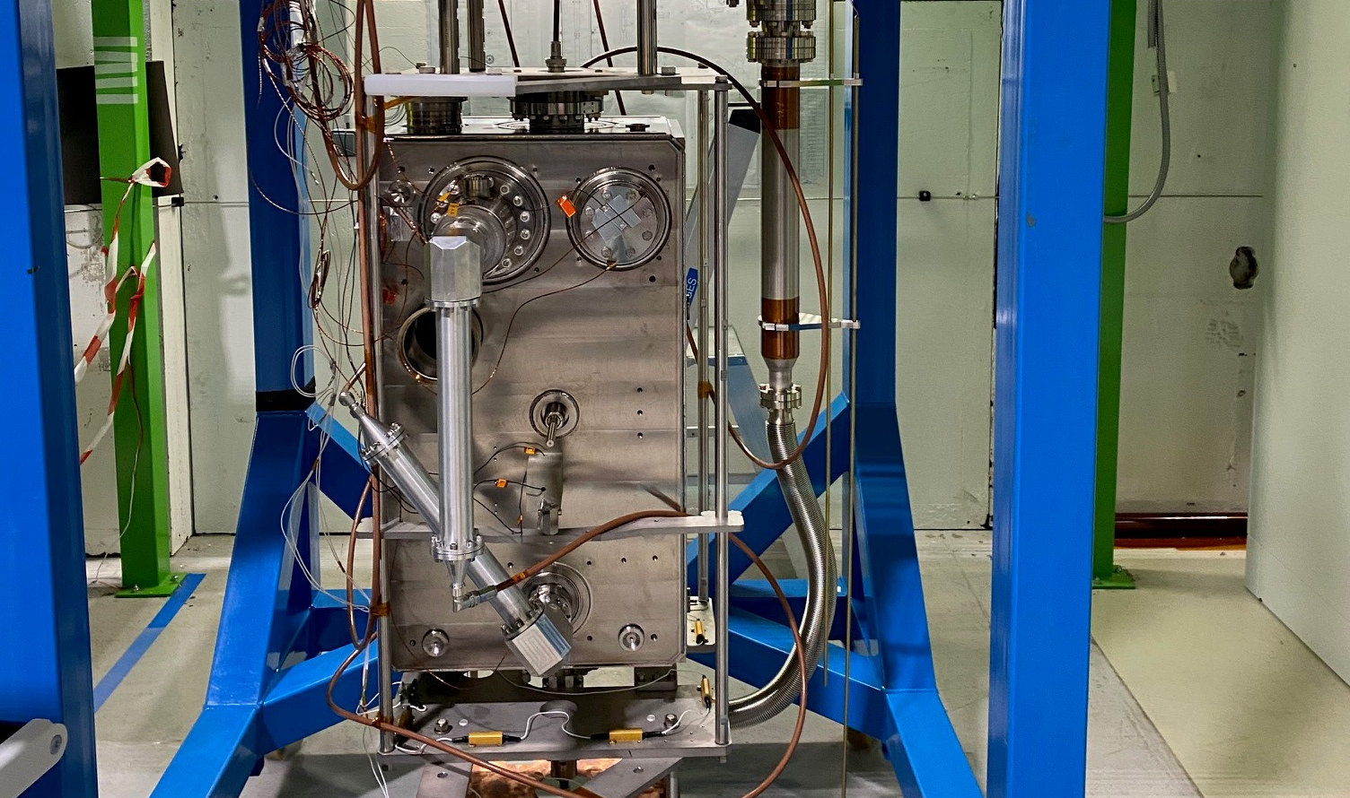
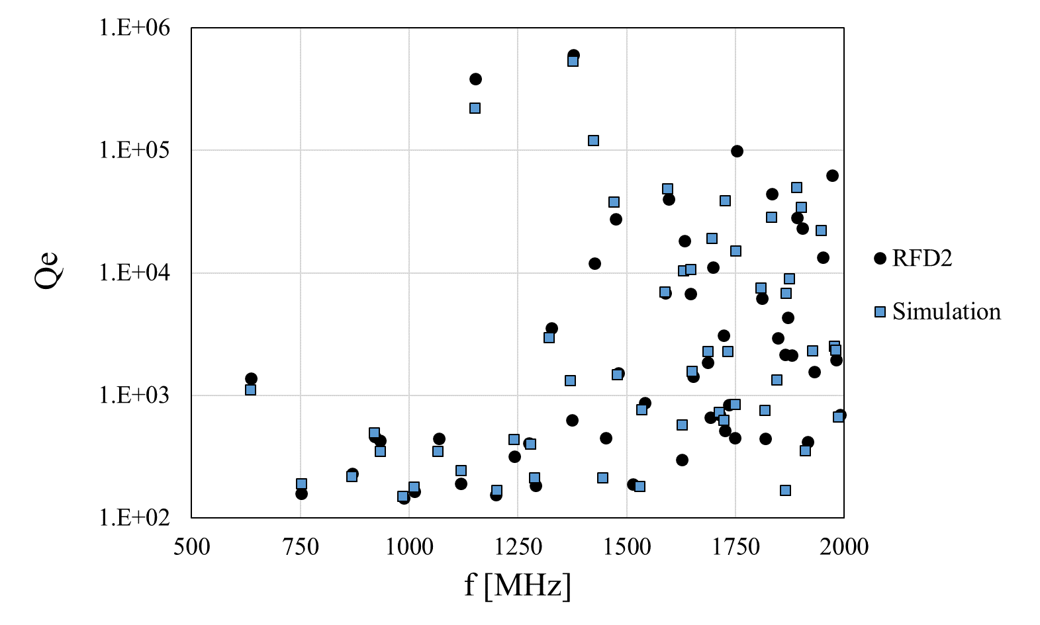
HOM measurements
HOM measurements verify damping requirements and quantify deviations
All met acceptance criteria!
Measured f and Q deviations from simulation!

Slide 22
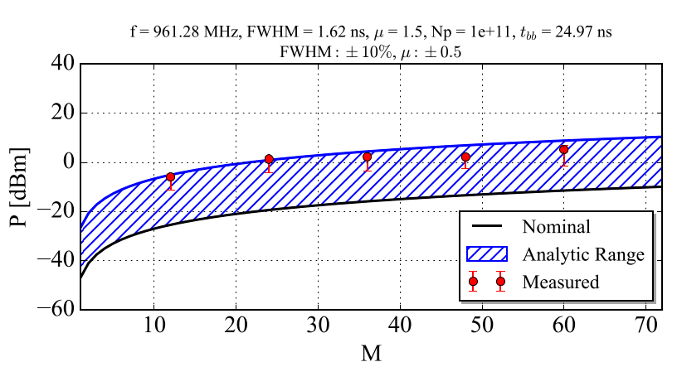
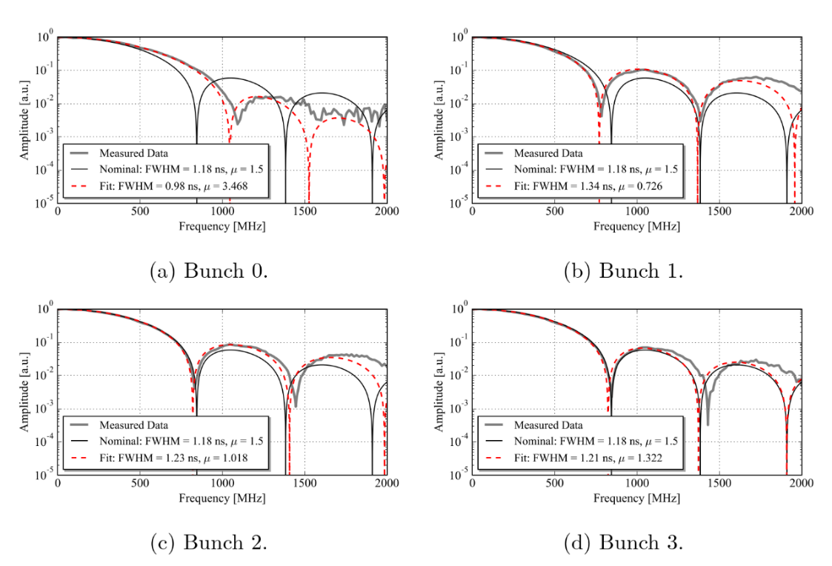
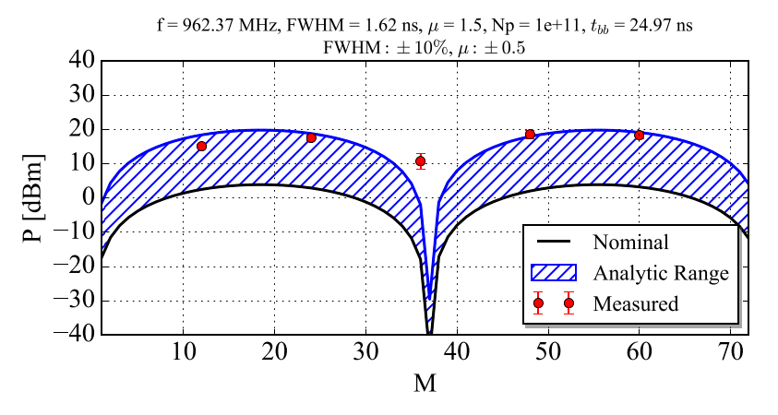
HOM measurements with beam
Crab cavity (DQW) measured with proton beam for first time in Super Proton Synchrotron (SPS) at CERN.
Measurements at bunch spacing harmonics matched well with simulations
Measurements at HOM frequencies did not always match perfectly.
Bunch profile and inter-bunch deviations MUST be taken into account when predicting HOM performance characteristics.

Slide 23
Conclusions
ERL high beam currents can produce large HOM power | High power handling damping mechanisms needed
Experience at CERN with High Power SC HOM couplers
Coupling mechanisms
Fundamental rejection and dynamic heat loads | Stopping the field BEFORE the gasket… maybe not necessary in the future?
HOM damping and high power HOMs
25 ohm characteristic impedance
Test-boxes | Qualify couplers and implement selection criteria
HOM measurements | Stochastic simulations with mode parameters
Measurements with beam | Stochastic simulations with bunch characteristics

Slide 24
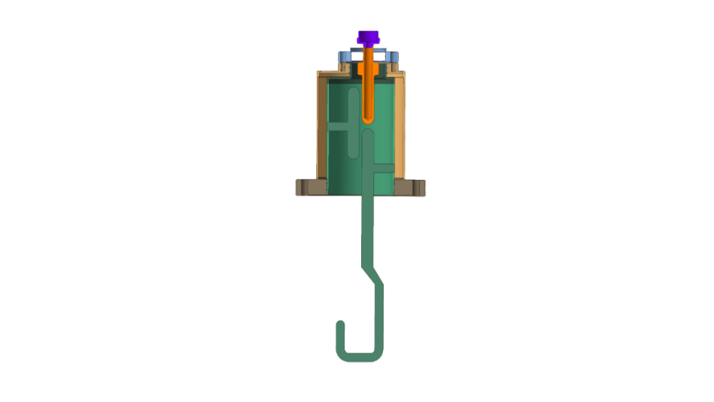

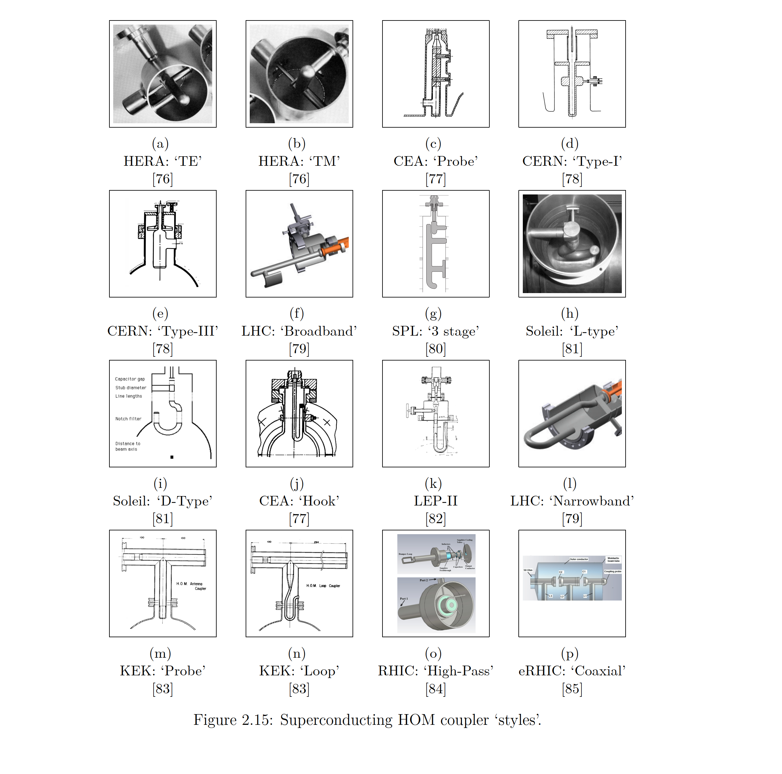
Thanks… Questions
Thank you for the invitation to speak and share!
Thanks my management for the great opportunities.
Thanks to Rama, Ofelia and the HiLumi project management for such interesting work.
Thanks to Seb, Antoine, Stefanie, our colleagues in SM18 and in EN-MME for the amazing work, collaboration and fruitful discussions.

Slide 25
References
[1] PhD Thesis, J. Mitchell (2019)

